Slide 1



VJAMS

Slide 2
VJAMS
VJAMS is an IoT metering company
which provides meters for energy, water, gas, etc. to house owners.
BAN 610: Database Management & Application Fall, 2022 Mid-Term Group Project - 5
Akhil Mohan - to6616
Megh Dave - cc3118
Sam Thomas - my4704
Varshini Kuppuraj - wd1464
Julian Antoine Honrado - hv1231

Slide 3
Smart metering helps consumers manage resource consumption more sustainably.
Providers can detect and remediate gas, energy or water leaks with greater speed. Without as much of a need for manual meter-reading and associated travel, vehicle emissions decrease.
Analysis can ensure providers correctly allocate water for optimal supply balance. As drought conditions continue to affect large swaths of the globe, this practice is a crucial step toward effective water conservation.
Smart meters make it easier for technicians to identify an outage’s cause and restore power without an in-person field inspection. Avoiding expensive truck rolls saves utility providers money — and gets customers back to normal faster.
WHY?

Slide 4






! YOU PAY FOR WHAT YOU USE AND SEE WHERE YOU LOSE

Slide 5
HOW WE DEVOLOPED A SYSTEM
VJAMS decided the following set of entities, attributes, and business rules to facilitate the type of data collection required.

Slide 6








Understanding the structure
Bathroom 1
Each house may have multiple lines
kitchen
Cities have multiple communities
Each Community has houses

Slide 7

Each house has Residents
One can have multiple houses linked to them
Residents may not own a house but require access
One or more may also be an admin
Empty houses may exist
multiple can be linked to one house

Slide 8


METERING
A meter has a unique ID and multiple readings.
The readings contain the time and date stamp.

Slide 9







VIEWS
Users receive all their data and analytics through a mobile application.
They also receive alerts and notifications via the application
ADMINS……
BILLS

Slide 10
VIEWS
ADMINS have an overall access and can also edit the data if necessary.
They receive an overview of the whole system.
And alerts from all houses.

Slide 11
VIEWS
ADMINS have an overall access and can also edit the data if necessary.
They receive an overview of the whole system.
And alerts from all houses.

Slide 12



BILL$$
A bill is assigned by the community to each house by multiplying the rate per unit with monthly usage. Each house then pays for the bill. The bill is identified by its bill number.

Slide 13
ERD

Slide 14
ERD
ENTITIES :
House
Resident
Community
Bill
Meter and Reading

Slide 15
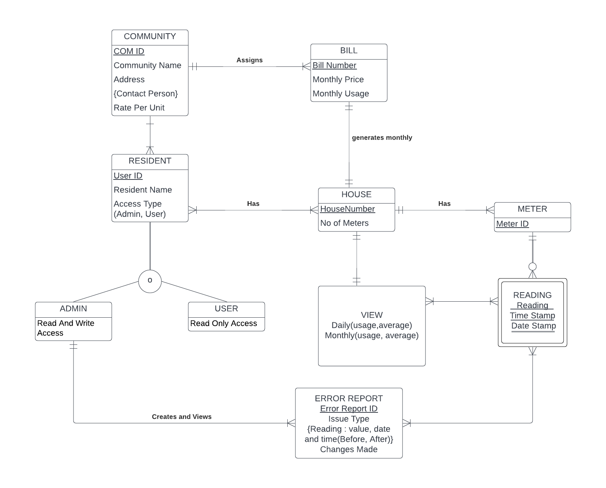
ERD

Slide 16
LOGICAL DESIGN

Slide 17
LOGICAL DESIGN
Community (COMID, CommunityName, Address, RatePerUnit)
Contact Person (COMID, ContactPerson)
Resident (UserId, ResidentName, Admin, User, COMID)
Admin (AUserID, ReadandWriteAccess)
User (UUserID, ReadOnlyAccess)
Bill (BillNbr, MonthlyPrice, MonthlyUsage, COMID)
House (HouseNbr, NoOfMeters, BillNbr)
OwnedHouse (UserID, HouseNbr)
….

Slide 18
LOGICAL DESIGN
….
Meter (MeterID, HouseNbr)
Reading (MeterID, Reading, DateStamp, TimeStamp)
View (HouseNbr, MeterID, DailyUsage, DailyAverage, MonthlyUsage, MonthlyAverage)
Error Report (ErrorReportID, IssueType, ChangesMade, AUserID, MeterID)
Error Reading (ErrorReportID, BeforeValue, BeforeDate, BeforeTime, AfterValue, AfterDate, AfterTime)

Slide 19
LOGICAL DESIGN

Slide 20
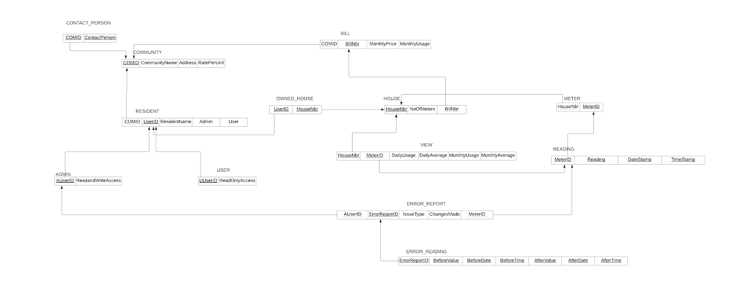
LOGICAL DESIGN

Slide 21
LOGICAL DESIGN

Slide 22
Implementation
In SQL

Slide 23
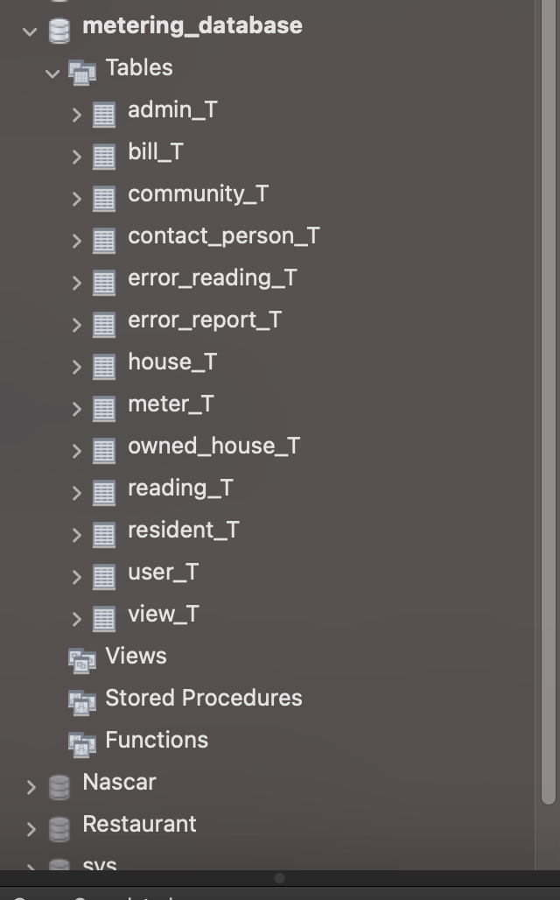
Schema

Slide 24
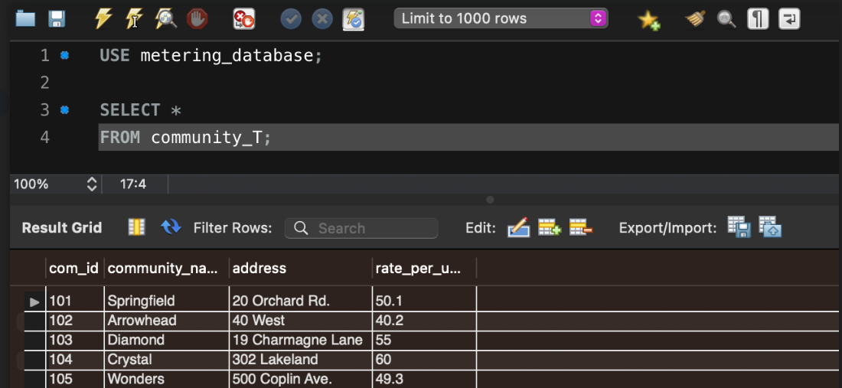
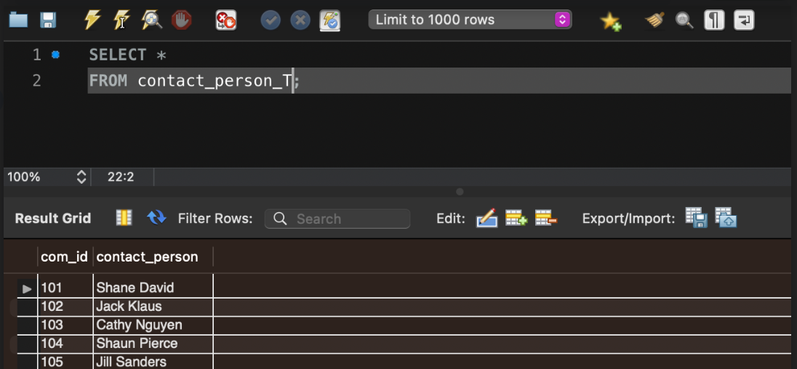
Tables – Community and Contact Person

Slide 25
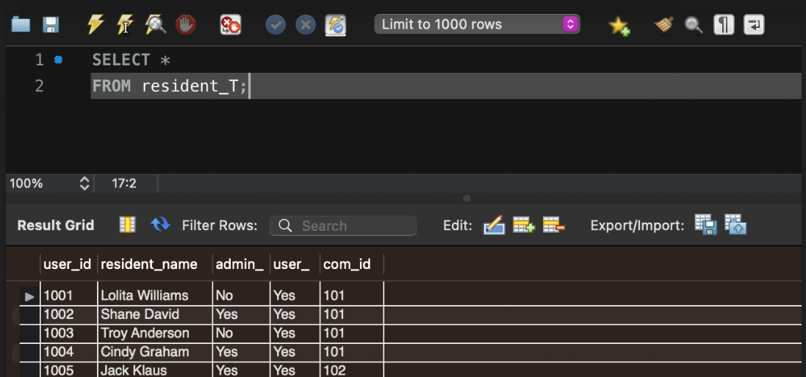
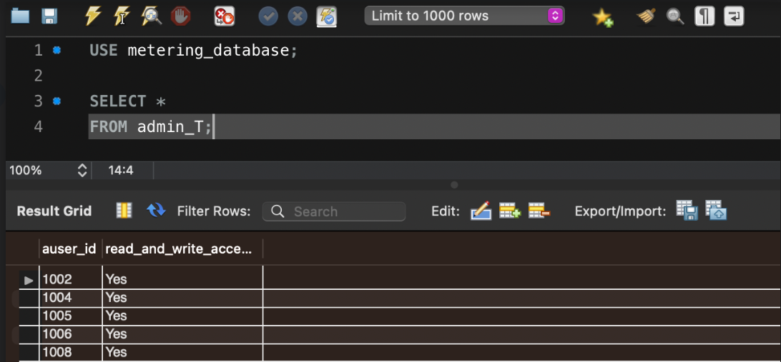
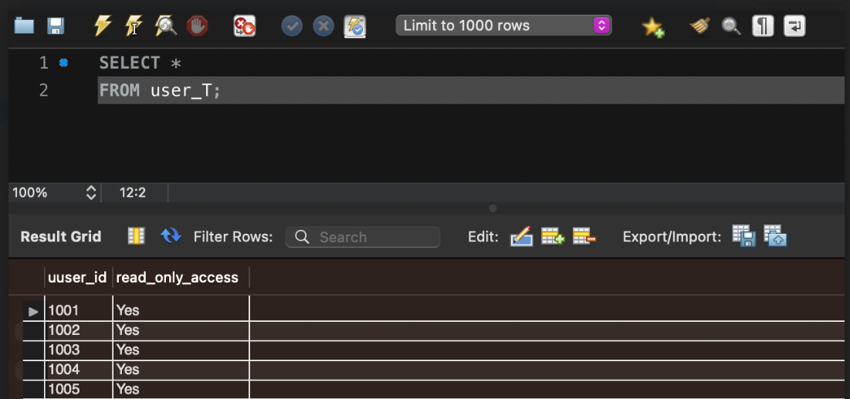
Tables – Resident, Admin and User

Slide 26
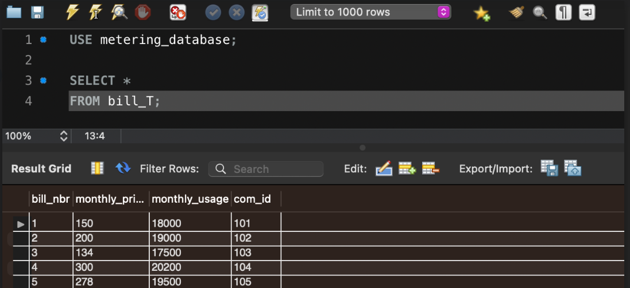
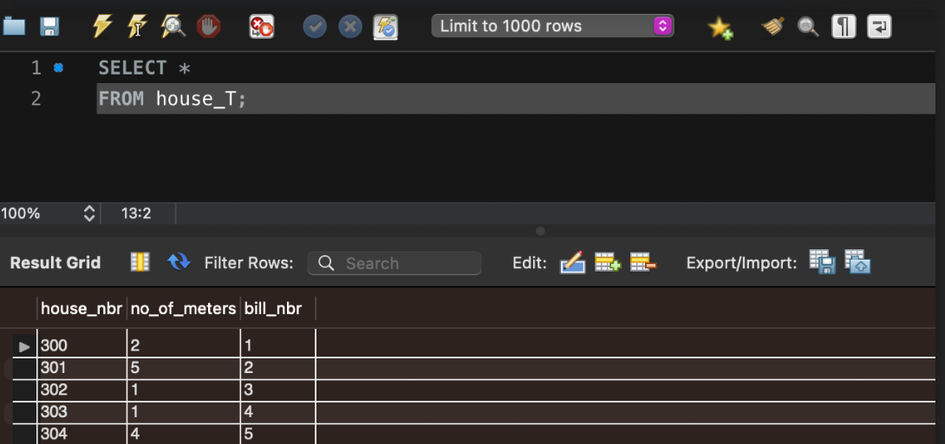
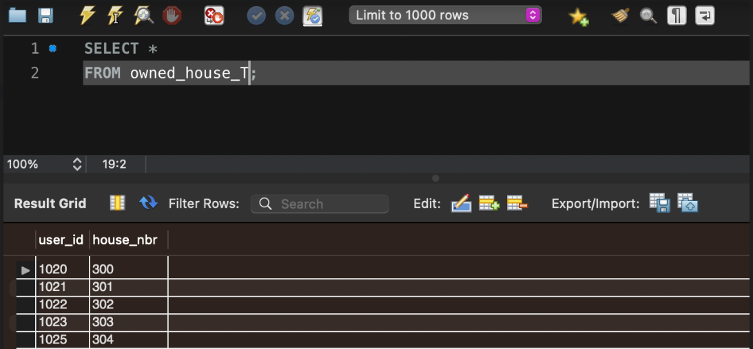
Tables – Bill, House and Owned House

Slide 27
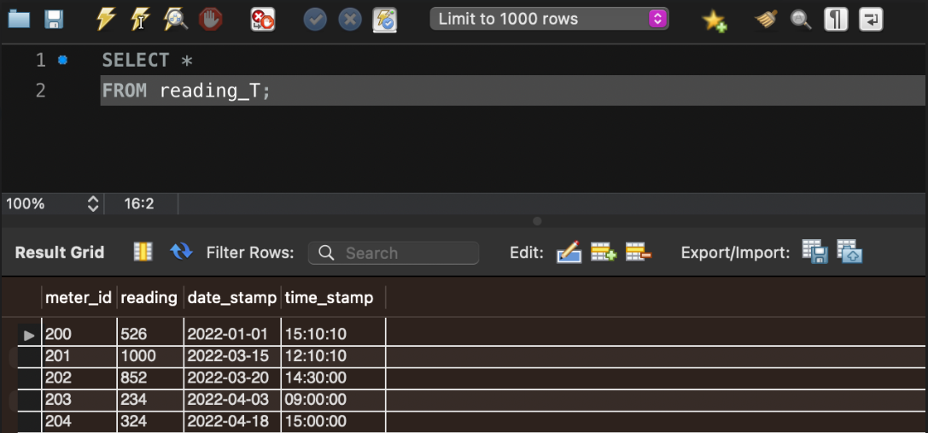
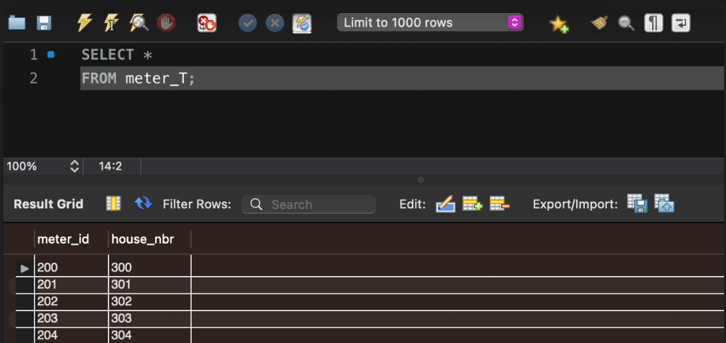
Tables – Meter and Reading

Slide 28
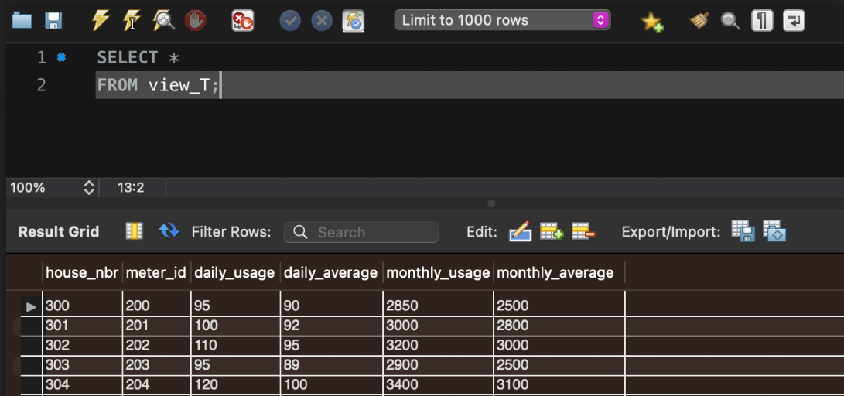
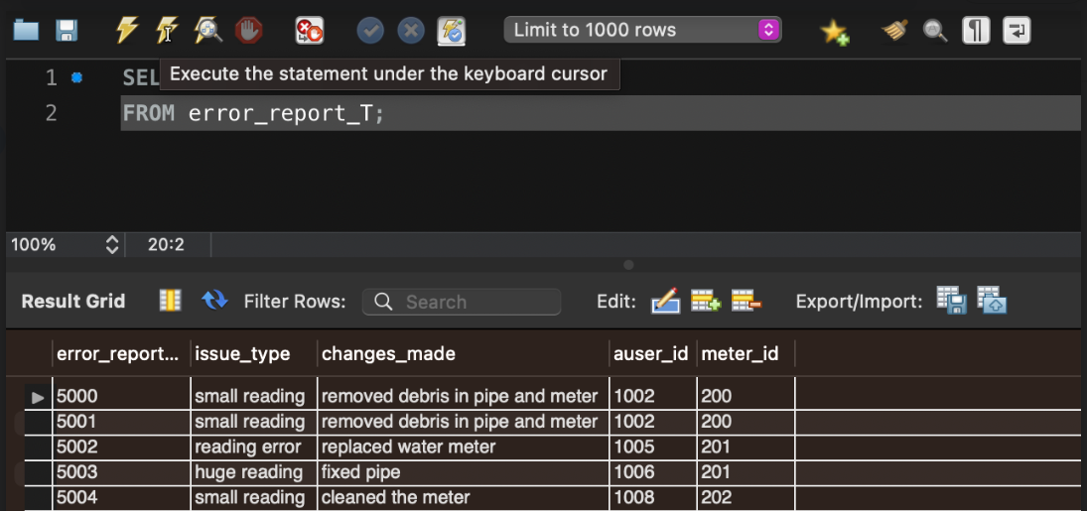
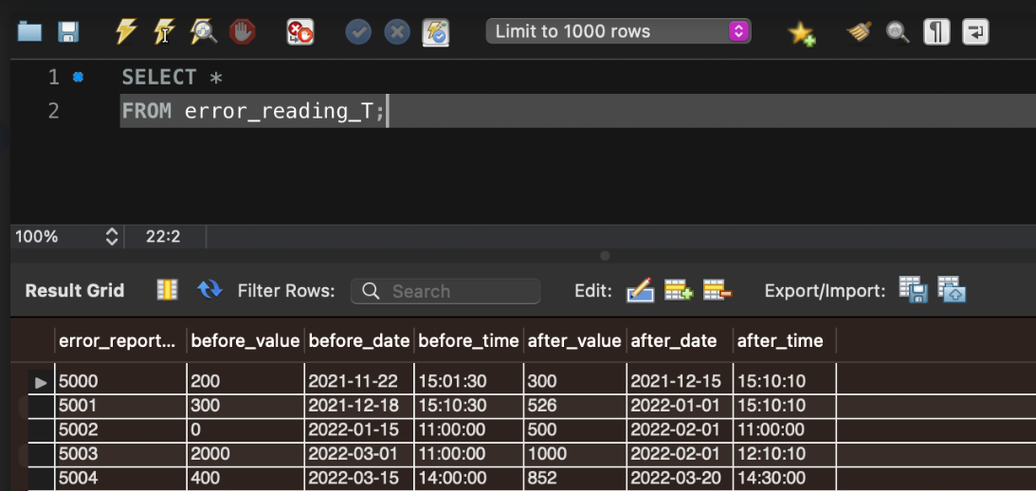
Tables – View, Error Report and Error Reading

Slide 29
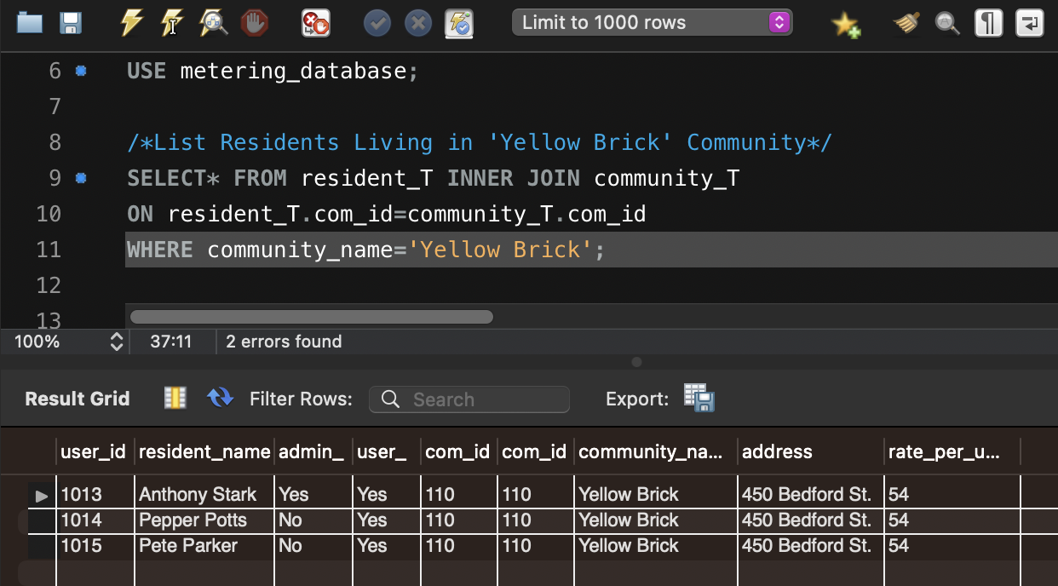
Queries
Residents Living in the Yellow Brick Community

Slide 30
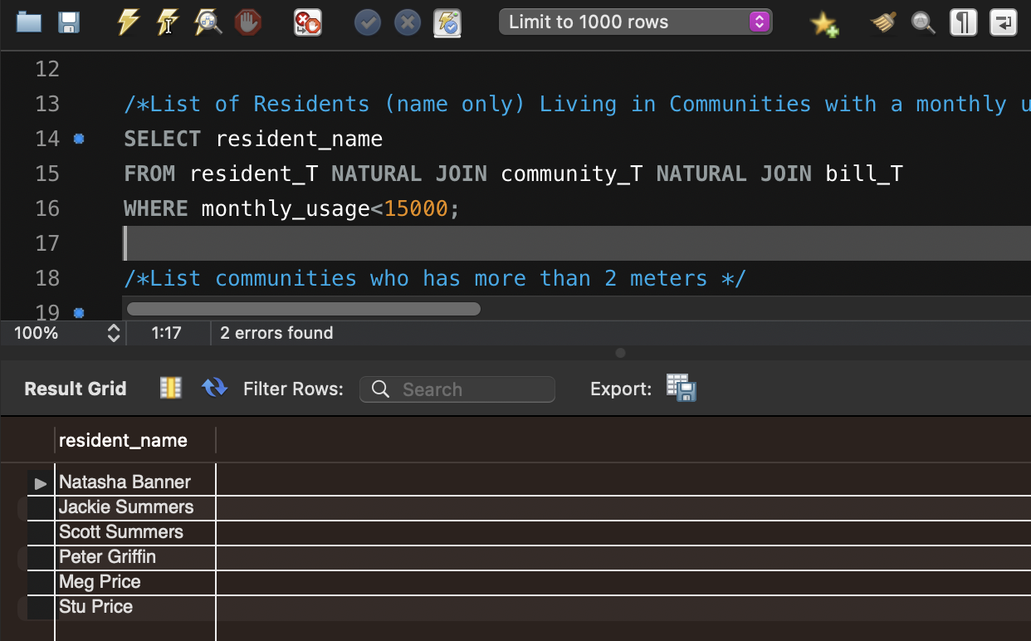
Queries
Names of Residents Living in Communities with A Monthly Usage of Less than 15,000

Slide 31
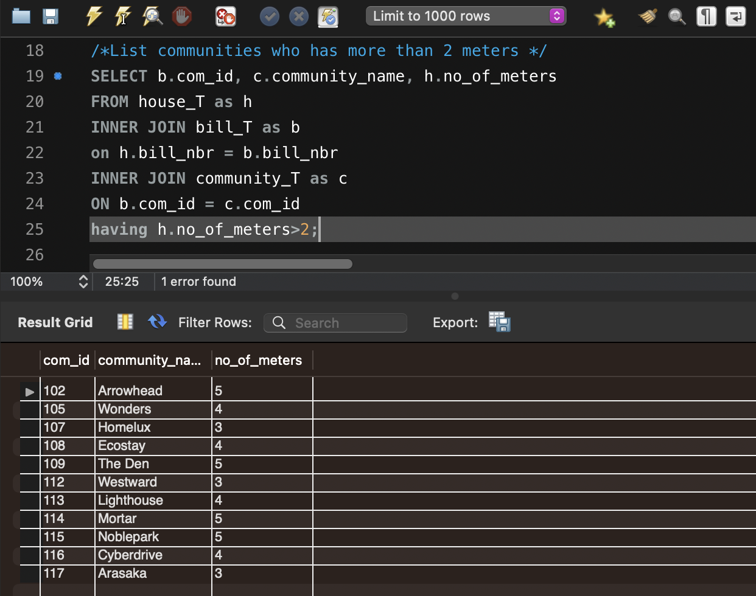
Queries
List of Communities That Have More Than 2 Meters

Slide 32
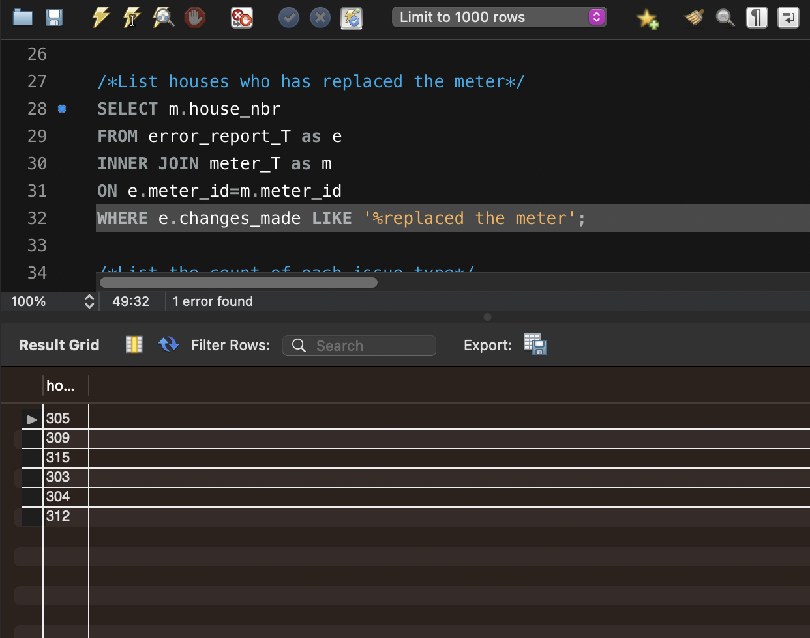
Queries
List of Houses Who Have Replaced Their Meters

Slide 33
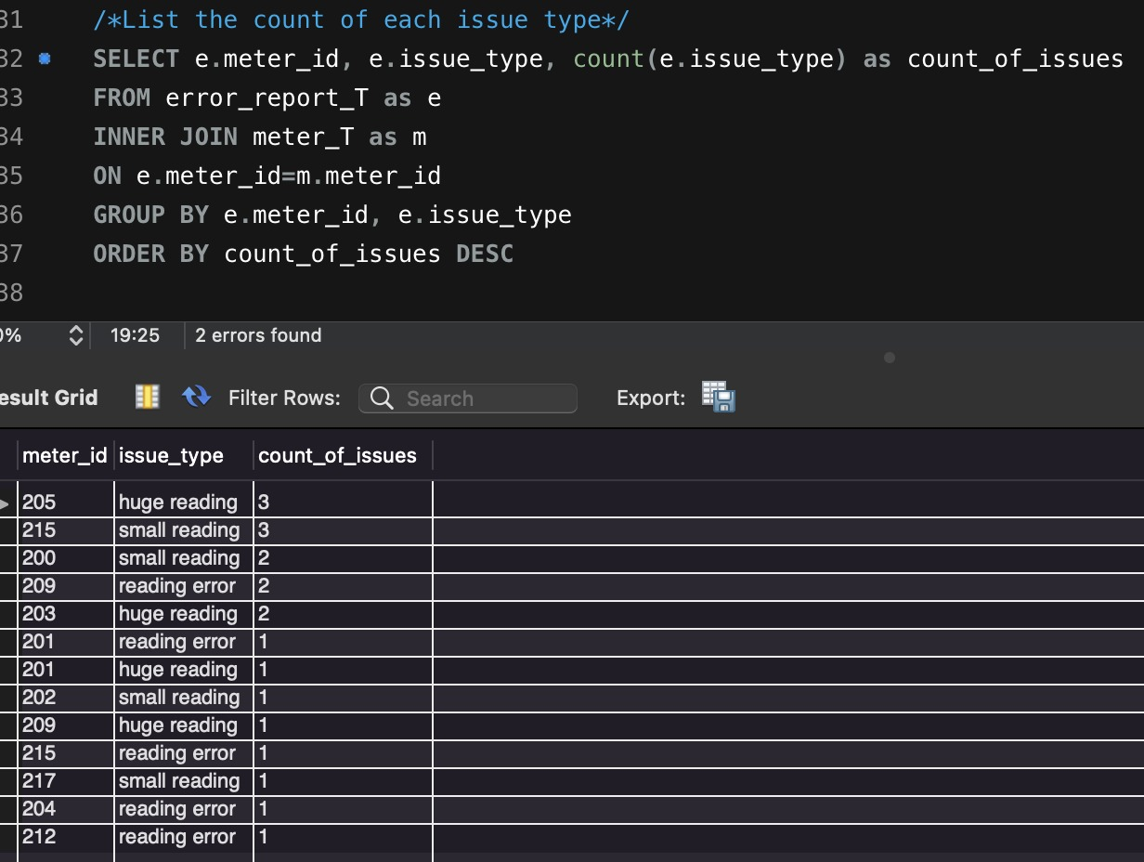
Queries
List of the Count of Each Issue Type per Meter ID

Slide 34
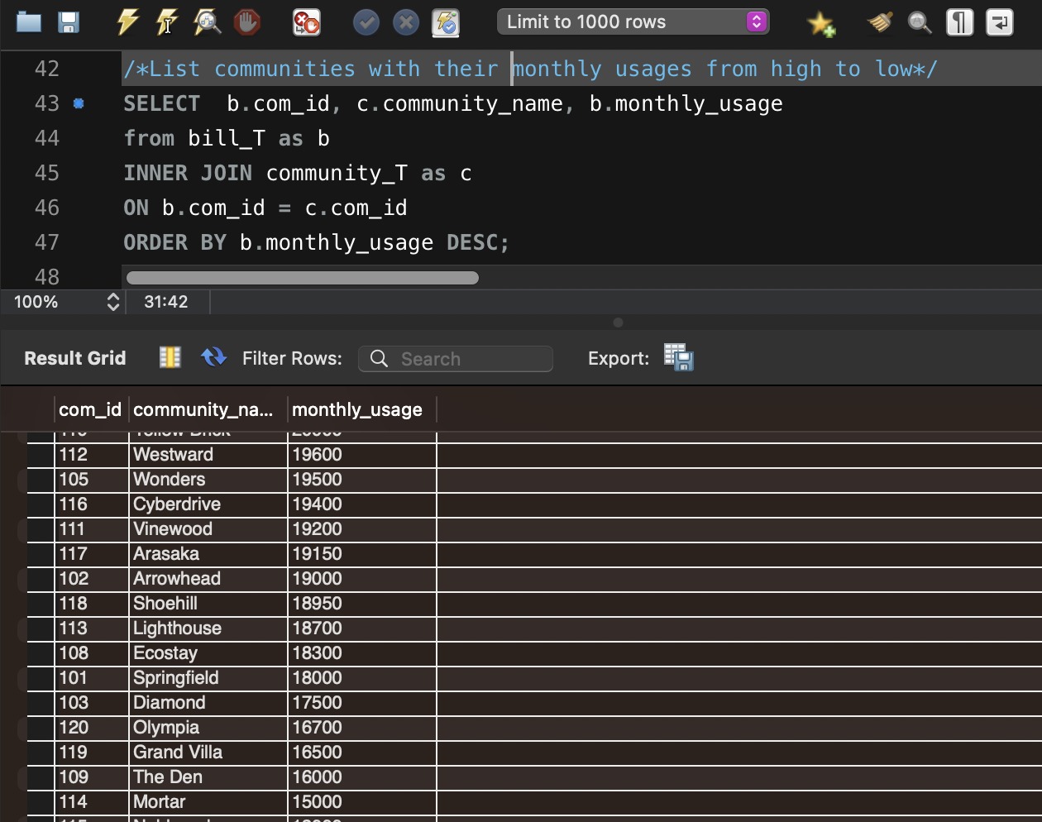
Queries
List of Communities w/ Their Monthly Usages in Descending Order

Slide 35
THANK YOU !

